Slide 1
Meet the Teacher Curriculum Evening
6th September 2021

Slide 2
HGIOS 2.2 - Curriculum
All stakeholders contribute to the rationale, design and ongoing development of the curriculum.
Everyone understands what the school is trying to achieve through its curriculum.
https://www.menti.com/qi6f7vehb8

Slide 3
How do we deliver it at West Linton Primary School?
What is curriculum for Excellence all about?
The National Picture
Curriculum Rationale - 2019
Next Steps - 2021
Vision, Values & Aims - 2018
What are we planning to do next?
Curriculum Plan - 2020
What developments did we have planned over the course of the National Lockdown?
Did we achieve them?

Slide 4
The National Picture
Curriculum Rationale - 2019
Next Steps - 2021
Vision, Values & Aims - 2018
Curriculum Plan - 2020

Slide 5
What is a Curriculum for Excellence?

Slide 6
What is a Curriculum for Excellence?

Slide 7
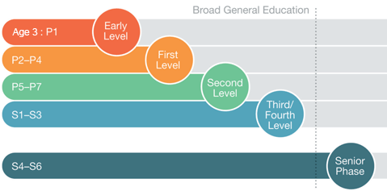
What is a Curriculum for Excellence?

Slide 8
The National Picture
Curriculum Rationale - 2019
Next Steps - 2021
Vision, Values & Aims - 2018
Curriculum Plan - 2020

Slide 9
Vision and Values
Vision – “Learning together to achieve our best”
Values – Kind,
Respectful
Honest

Slide 10
Our Aims
To ensure all pupils receive a high quality inclusive education in order to become confident individuals, effective contributors, responsible citizens and successful learners.
To work in collaboration with our community and stakeholders to promote quality opportunities for our young people.
To build and develop resilient pupils equipped to tackle problems in their life and learning with a growth mind set.
To ensure all pupils are Safe, Healthy, Achieving, Nurtured, Active, Responsible and Respected.

Slide 11
The National Picture
Curriculum Rationale - 2019
Next Steps - 2021
Vision, Values & Aims - 2018
Curriculum Plan - 2020

Slide 13
The National Picture
Curriculum Rationale - 2019
Next Steps - 2021
Vision, Values & Aims - 2018
Curriculum Plan - 2020

Slide 15
Our Curriculum Bundles

Slide 16
Our Curriculum Bundles

Slide 17
Our Curriculum Bundles
https://www.menti.com/gsc1u2shc9

Slide 18
The National Picture
Curriculum Rationale - 2019
Next Steps - 2021
Vision, Values & Aims - 2018
Curriculum Plan - 2020

Slide 19
What to expect next…
Outdoor Learning
Digital Technologies
Maths and Numeracy
https://www.menti.com/v9otv14axr

Slide 20
Opportunities for you to get involved…
Mathematics Focus Group
Outdoor Learning Focus Group
ICT Focus Group
Padlet Sign Up

Slide 21
Thank you for listening

